Slide 1
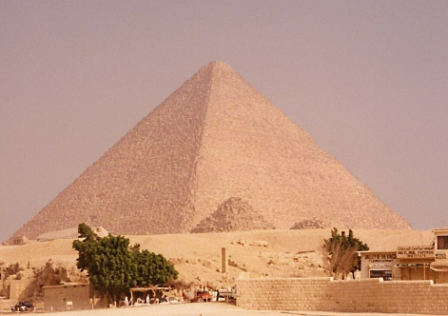
Turning history on its head
Massive evidence of a global flood
What does it all mean?
Part 7 – The REAL Age
of All This
End Time Issue Ministries
Dr James A Robertson PrEng
Notes:
Pyramid, Northcliff, Granite?

Slide 2
A massive hydraulic and tectonic event
How long ago?
Each stage of what has been discussed happened rapidly
More likely to be weeks or months per stage rather than millions or billions of years
There are written records that suggest this happened as recently as 2345BC
Other widely held opinions state that these events took place millions or billions of years ago
Which view is more reliable?
Notes:
Everything points to a massive hydraulic and tectonic event
Take time to ponder and i am sure that you will draw the same conclusion that i have, there does not appear to be any other explanation to fit the visible facts

Slide 3
Exponential characteristics
Thousands of years
versus
Millions of years

Slide 4
The dilemma of the “God’s Word” phenomenon
The Bible is the word of God and without error
The Bible says there was a flood
I believe the Bible
So that settles it!
THERE WAS A FLOOD!
But nowhere in the book (Greek biblios = book) does the bible claim to be without error or to be “the Word of God”
It IS a book containing a collection of historical records
Notes:
Engineering practice prohibits material extrapolation – search on the Net for a quote
All historical theories about the age of the earth, evolution that rely on millions of years steady state radioactivity, etc are at best fatally flawed and at worst utter foolishness

Slide 5
The dilemma of the “my teacher told me” phenomenon
Professor ... told me
There was NO flood
This planet came into existence 4.55 billion years ago plus or minus 1%
Everything happened gradually
There is nothing to discuss
But we have no way of knowing what happened millions of years ago
It is pure speculation
We must look at current practical facts
Notes:
Engineering practice prohibits material extrapolation – search on the Net for a quote
All historical theories about the age of the earth, evolution that rely on millions of years steady state radioactivity, etc are at best fatally flawed and at worst utter foolishness

Slide 6
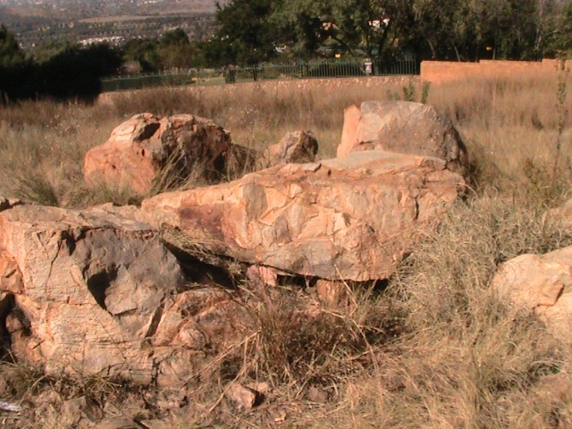
The problem of clean sharp corners
All over the world we find clean rocks with sharp corners
Over millions or billions of years these corners would be weathered and rounded by thermal stressing and covered with moss and lichen
Millions of years is
improbable
Are there other indicators
of age?
Notes:
Remember the clean, sharp corners of the rocks
Northcliff, Swartruggens, Victoria Falls, etc – no evidence of millions of years of wear and rounding
Granite in the valleys of Johannesburg
No lichen, no heat rounding, no rain rounding, clean sharp corners

Slide 7
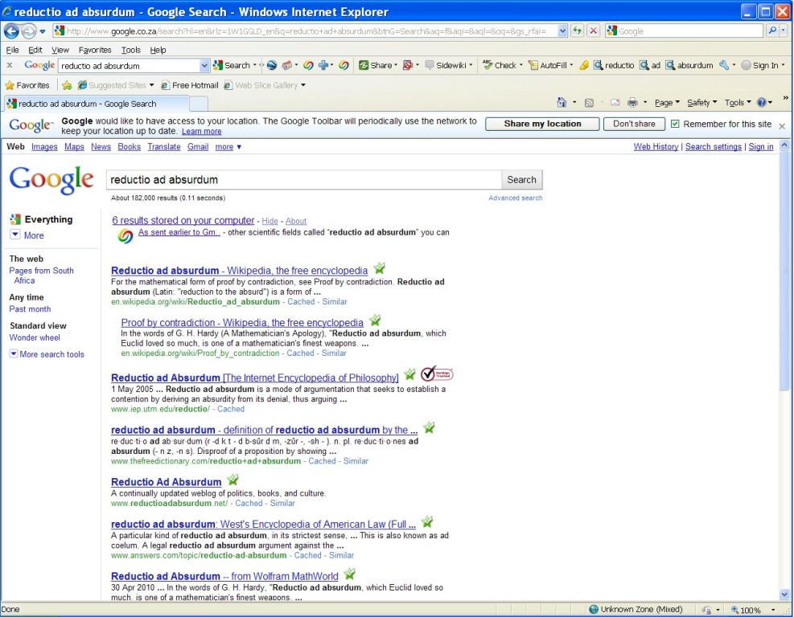
Mathematics and Law Reductio ad absurdem Reduce to the absurd
Google 182,000 occurences ➔ widely recognized approach
Reduce to the absurd or proof by contradiction
Fundamental logical, mathematical and legal principle
R e c a p
Reductio ad absurdum (Latin: "reduction to the absurd") is a form of argument in which a proposition is disproven by following its implications to a logical but absurd consequence.^{[1]}
A particular kind of reductio ad absurdum, in its strictest sense, is proof by contradiction (also called indirect proof) where an assumption is proven false because it leads to a contradiction
In logic, proof by contradiction is a form of proof that establishes the truth or validity of a proposition by showing that the proposition being false would imply a contradiction.
From Wikipedia
Notes:
Look for quotes etc that were used in the evolution book

Slide 8
Millions or billions of years Reduce to the absurd
“We know the radioactive decay rate of … ”
“We have no basis to assume that there has been a non-linear trend”
Everything so far in this presentation indicates
massively non-linear events
Written records going back thousands of years
indicate a recent event
Millions of years is therefore highly improbable, technically unsound and logically probably absurd
Notes:
Quote from Genesis about the flood – also later quotes?
Incidentally, the boat (Ark meaning container) has been found – artists impression of Ark from Jonathan or elsewhere

Slide 9
The “Bible” is the “Word of God” and without error -- reduce to the absurd
A collection of writings by assorted people
Nowhere in the book is there a passage that unambiguously catalogues the content of the book and defines its scope
There are books of the same name that have different compilations and literally hundreds of different English versions
Nowhere in the book does it claim that the entire compendium of writings is without error
Nowhere in the book does it claim that the entire compendium of writings is the “word of God” or “Yah” (the true name of the Creator
The “inerrant word of God / Yah” is therefore highly improbable
Notes:
Quote from Genesis about the flood – also later quotes?
Incidentally, the boat (Ark meaning container) has been found – artists impression of Ark from Jonathan or elsewhere

Slide 10
Could Genesis be correct?
At this point I suggest that the most that we can say about the book {bible} is that it is a collection of writings the oldest of them generally accepted to be at least 2,500 years old
The book claims that there was a global flood in about 2345 BC
At this stage let us NOT get into whether the flood was an act of a being whom is customarily referred to as “God” or “THE LORD” or even whether He exists or not
Let us simply say that “Genesis claims there was a global flood” and examine that portion of that book further
Notes:
Quote from Genesis about the flood – also later quotes?
Incidentally, the boat (Ark meaning container) has been found – artists impression of Ark from Jonathan or elsewhere

Slide 11
“Genesis” is a broadly reliable historical text -- reduce to the absurd
Genesis is presented as an historical account of REAL events
Can we validate this?
Minor errors are NOT a problem if we consider the writings to be the work of human beings who, like ourselves, make mistakes
Most specifically, CAN we regard reports of a global flood about 4,500 years ago as reliable?
Notes:
Quote from Genesis about the flood – also later quotes?
Incidentally, the boat (Ark meaning container) has been found – artists impression of Ark from Jonathan or elsewhere

Slide 12
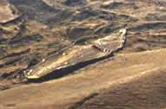
Noah’s Ship (Ark) found (about 2345BC)
Genesis 7:11-12 “In the six hundredth year of Noah's life, in the second month, the seventeenth day of the month, on that day all the fountains of the great deep were broken up, and the windows of heaven were opened. And the rain was on the earth forty days and forty nights.” NKJV
Genesis 8:3-4 “And the waters receded continually from the earth. At the end of the hundred and fifty days the waters decreased. Then the ark rested in the seventh month, the seventeenth day of the month, on the mountains of Ararat.” NKJV
Remains of a huge wooden vessel submerged in a volcanic mudflow found in the mountains of Ararat in Turkey
Size agrees with Genesis 6:15 length 150 meters, width 25 meters and height 15 meters
Notes:
Quote from Genesis about the flood – also later quotes?
Incidentally, the boat (Ark meaning container) has been found – artists impression of Ark from Jonathan or elsewhere

Slide 13
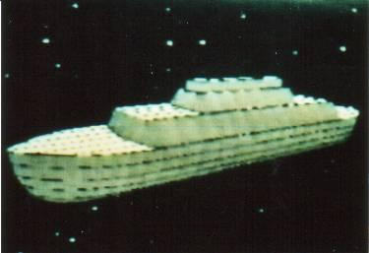
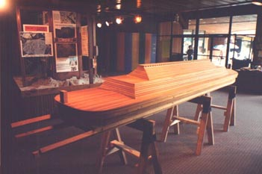
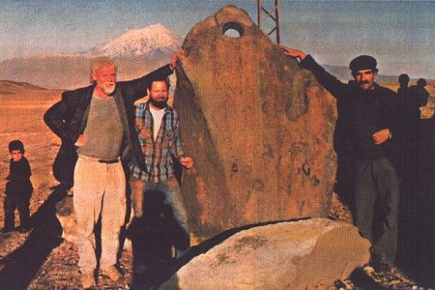
Noah’s Ship (Ark) found (about 2345BC)
Computer model of the Ark
Physical model of the Ark
Also found:
Drogue stones
Noah’s house and grave
Noah was about six (6) meters tall
Notes:
Quote from Genesis about the flood – also later quotes?
Incidentally, the boat (Ark meaning container) has been found – artists impression of Ark from Jonathan or elsewhere

Slide 14
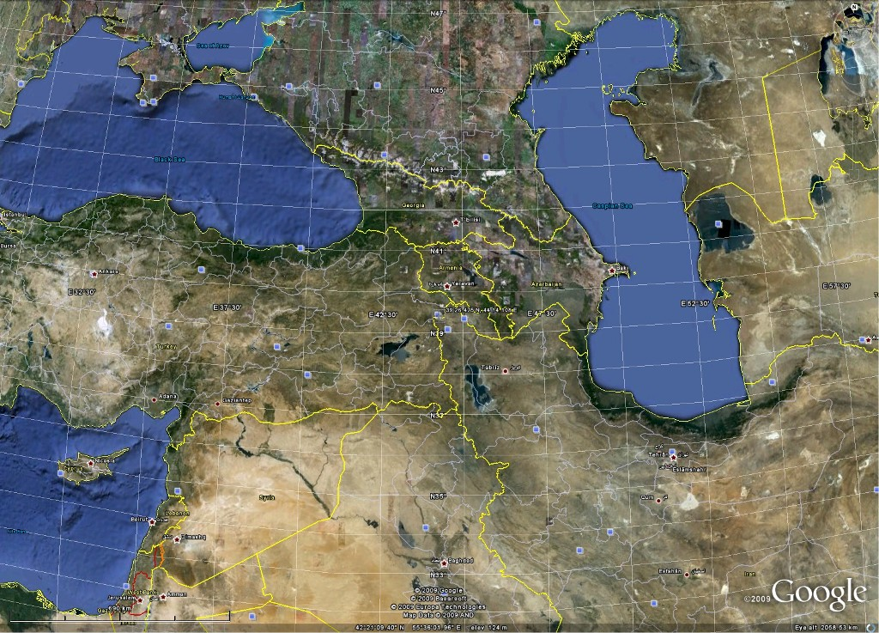
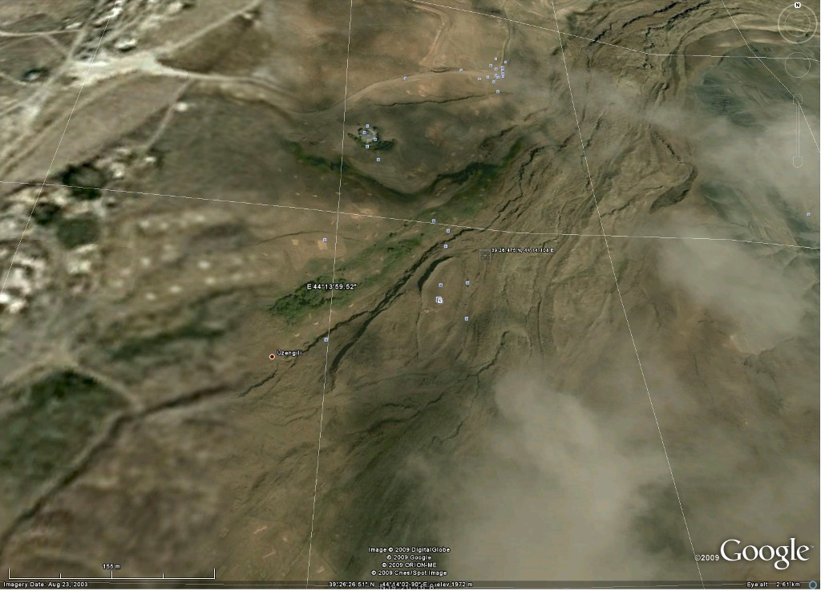
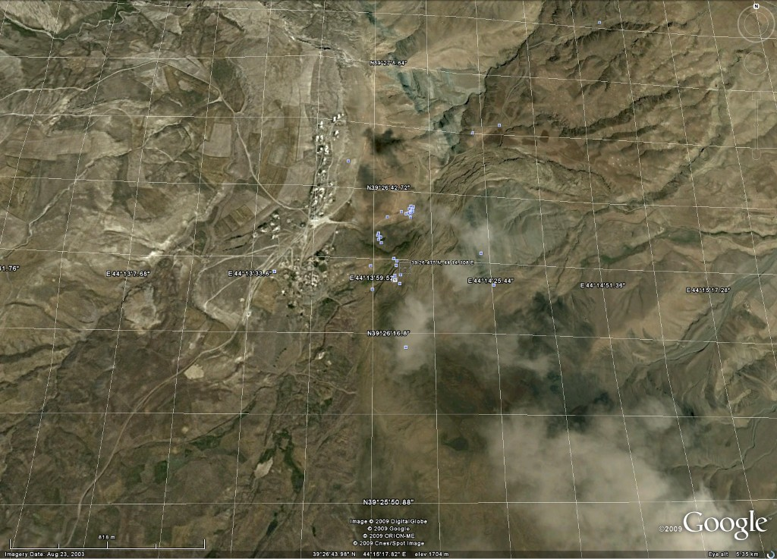
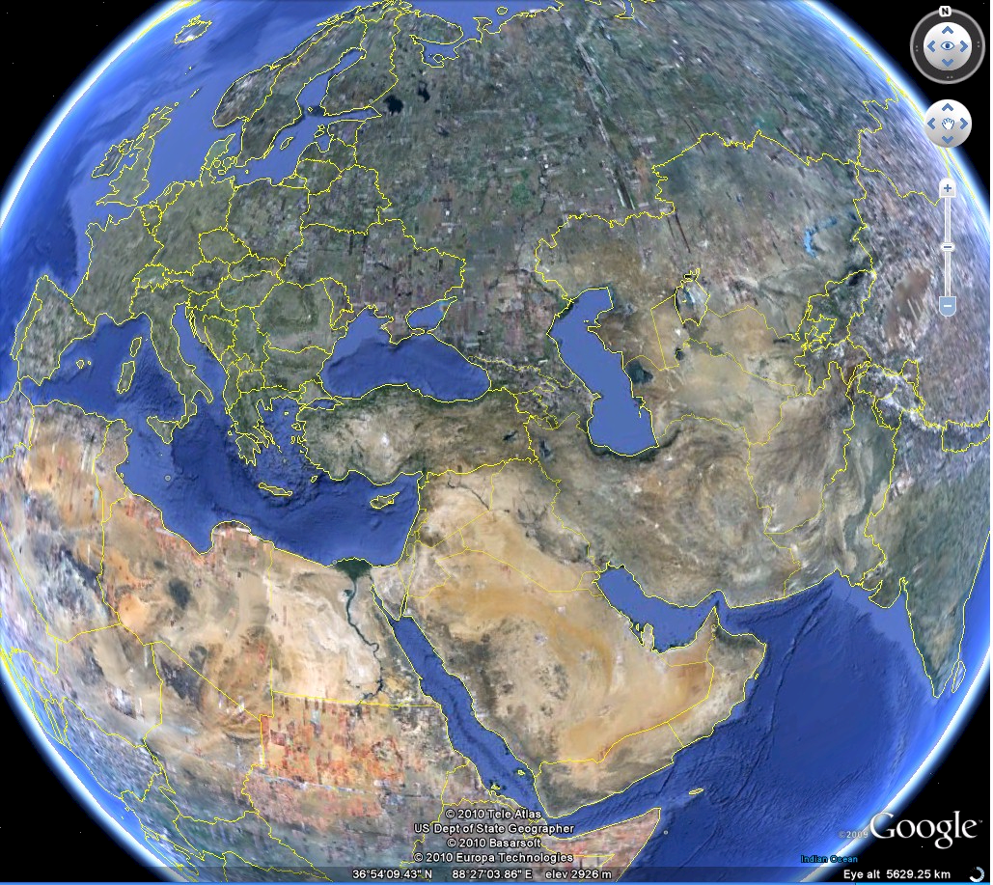
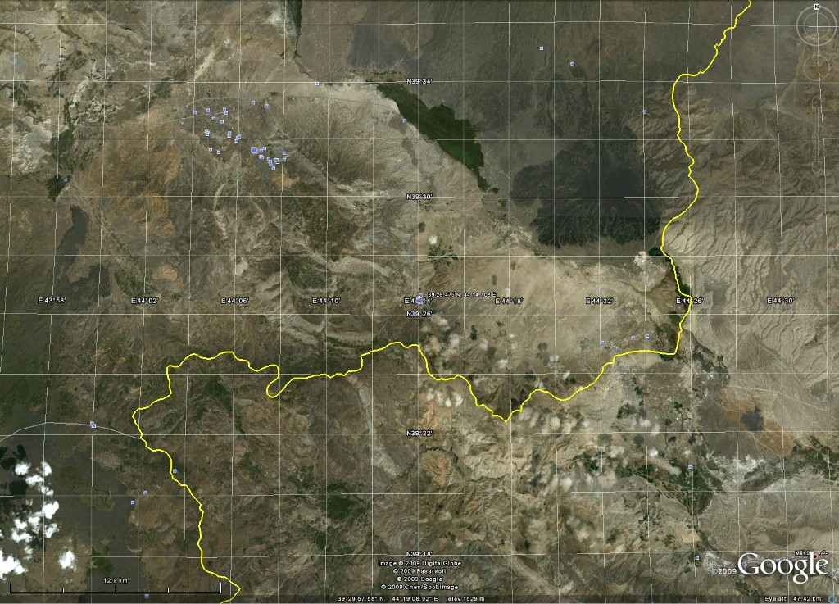
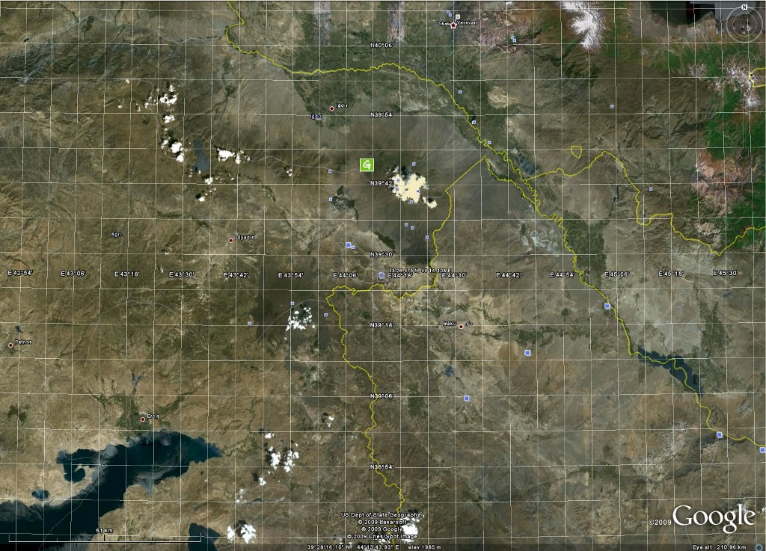
Genesis is a broadly reliable historical text – Noah’s Ship (Ark = Container) found (about 2345BC)
Notes:
Quote from Genesis about the flood – also later quotes?
Incidentally, the boat (Ark meaning container) has been found – artists impression of Ark from Jonathan or elsewhere

Slide 15
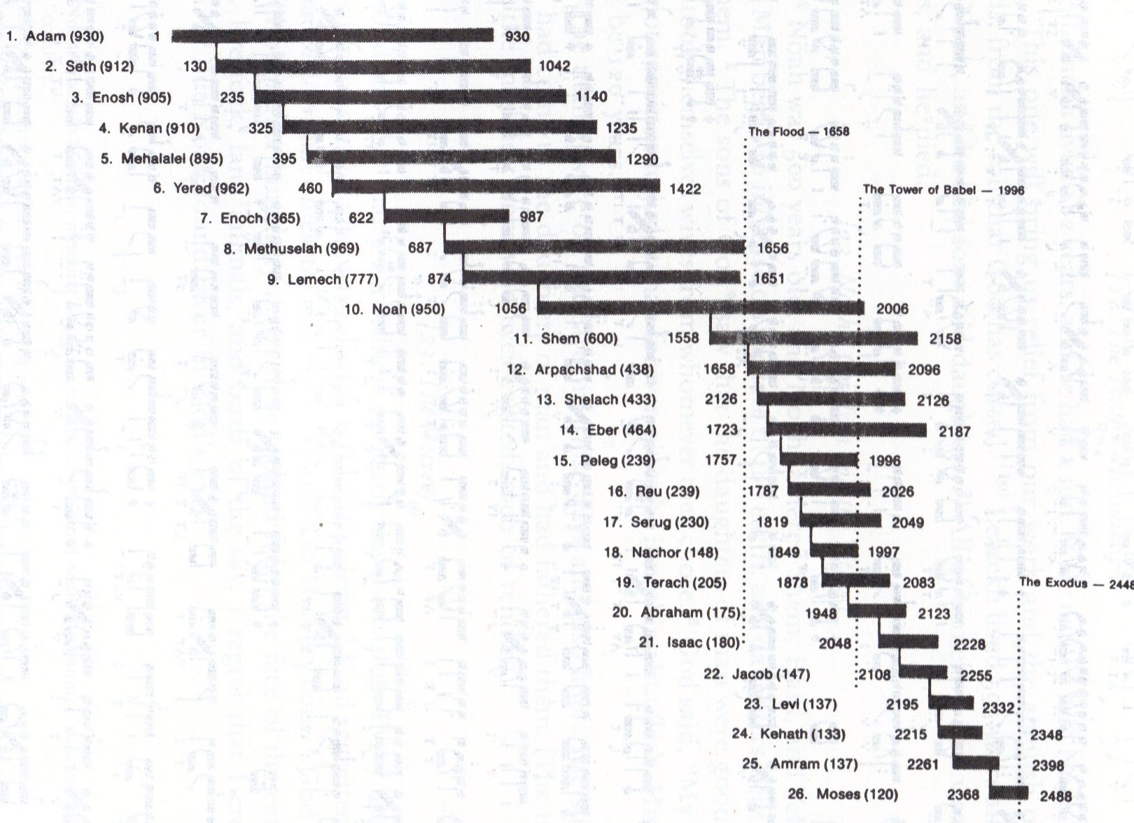
Detailed genealogies
Flood 1658
years from start of genealogy
Notes:
Quote from Genesis about the flood – also later quotes?
Incidentally, the boat (Ark meaning container) has been found – artists impression of Ark from Jonathan or elsewhere

Slide 16
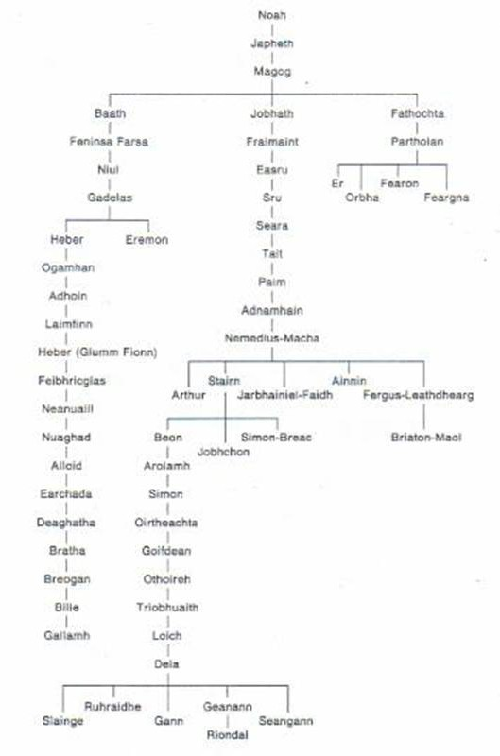
Irish genealogies agree
Notes:
Quote from Genesis about the flood – also later quotes?
Incidentally, the boat (Ark meaning container) has been found – artists impression of Ark from Jonathan or elsewhere

Slide 17
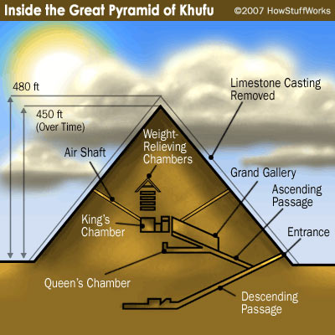
Egyptian time lines revisited
Egyptian time lines support a flood date of about 2345BC
Like many other advanced civilizations Egypt (Mitzraim) sprang up rapidly after the flood immediately with advanced technology
Once certain wrong assumptions with regard to the Egyptian dynasties are resolved Egyptian timelines correlate
Likewise other advanced civilizations around the world – Babylon, Matchu Pitchu, etc, etc, etc
It is doubtful whether we have the technology to build the Great Pyramid today!
Notes:
Quote Jonathan – refer to Dating Blunder, photo of book or cover, quote relevant passage, look for other quotes, maybe ask Jonathan for a short paragraph summing up what he considers most important on Egypt and on Age or even make a recording?
Refer back to time line and flea on the tail of an elephant

Slide 18
Genesis is a broadly reliable historical text -- reduce to the absurd
Large boat in the mountains of Ararat – confirmed
Genealogies – confirmed
CONCLUSION: It is absurd to disregard Genesis as a source of historical information – RECENT FLOOD CONFIRMED
Notes:
Quote from Genesis about the flood – also later quotes?
Incidentally, the boat (Ark meaning container) has been found – artists impression of Ark from Jonathan or elsewhere

Slide 19
Some useful references by Jonathan Gray
Killing of Paradise Planet – reconstruction of the earth before the flood
Surprise Witness – reconstruction of the events during the flood
The Corpse Came Back – reconstruction of the events following the flood, repopulation of the earth, dispersion of tribes and peoples
Dead Men’s Secrets – 1,000 archaeological findings that evidence that the civilization destroyed by the flood was far MORE SOPHISTICATED than our current civilization and had technologies we do not have today
Reading and videos to change your worldview available from www.beforeus.com or admin@ETIMin.org
Notes:
Quote from Genesis about the flood – also later quotes?
Incidentally, the boat (Ark meaning container) has been found – artists impression of Ark from Jonathan or elsewhere

Slide 20
Jonathan Gray regarding dating
Clearly there is a major problem with dating techniques
Some useful reading on the subject of dating from www.beforeus.com or admin@ETIMin.org
Notes:
Quote from Genesis about the flood – also later quotes?
Incidentally, the boat (Ark meaning container) has been found – artists impression of Ark from Jonathan or elsewhere

Slide 21
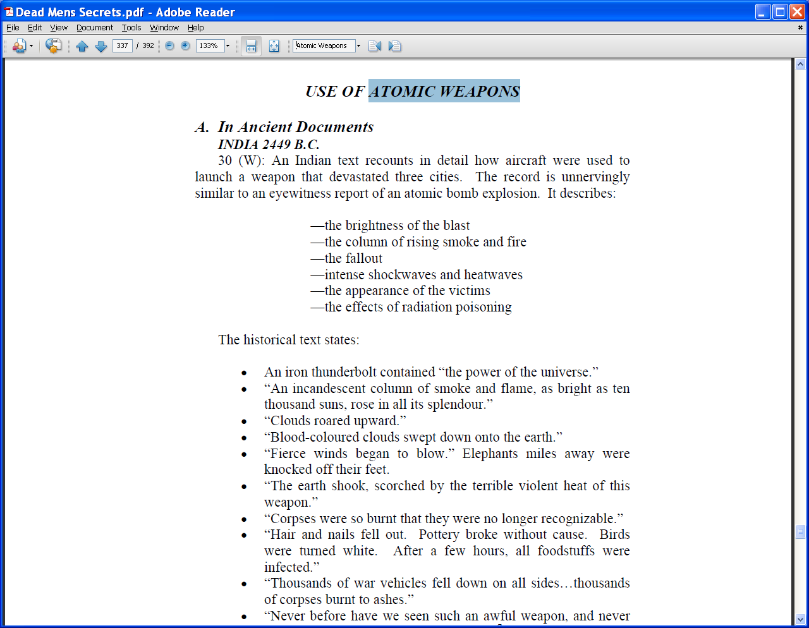
Another complication Global nuclear war about 4,000 years ago?
Remains of highly radioactive cities
Similar destruction to Hiroshima
Indications of nuclear bombs
Indications of nuclear war
Suggestions that Australopithecus are human beings deformed by exposure to nuclear radiation
Throws all theories of steady state nuclear decay into further disarray
Notes:
Quote Jonathan – refer to Dating Blunder, photo of book or cover, quote relevant passage, look for other quotes, maybe ask Jonathan for a short paragraph summing up what he considers most important on Egypt and on Age or even make a recording?
Refer back to time line and flea on the tail of an elephant

Slide 22
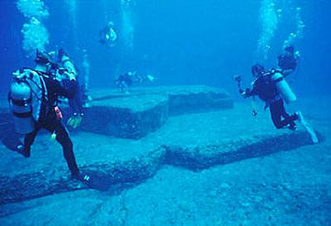
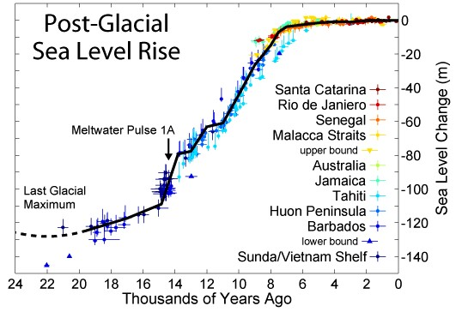
Total destruction of the surface of the earth less than 4,500 years ago disrupts many other theories
Global warming is a result of the earth continuing to dry out as water drains from the continents
So is the rising of sea levels – cities have been submerged
Races can all trace their origin back to Noah and his family – all differences are a consequence of degradation (negative evolution)
Evolution over millions of years is invalid
Dinosaurs lived recently, the Loch Ness Monster was probably real
Notes:
If this really did happen only 4,500 years ago, give or take a few thousand years then a massive amount of theory is totally trashed relating to man evolving over millions or billions of years and archaeological and other finds dated as being millions of years old are all incorrectly dated
Much of the rest of the data about the things dated this way is factually correct, it is the invalid extrapolation through the assumption of steady state earth and radioactivity, etc conditions that is fundamentally flawed

Slide 23
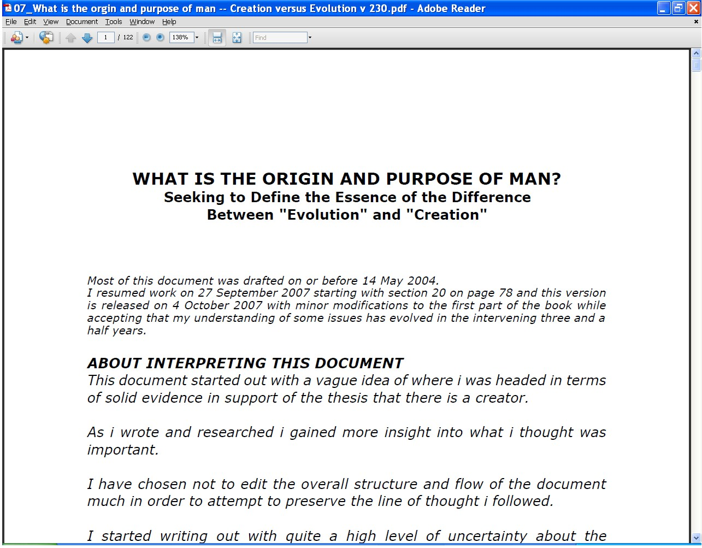
What is the Origin and Purpose of Man? “Evolution” and “Creation”
On the CD at the end of this DVD set or www.ETIMin.org
Notes:
If this really did happen only 4,500 years ago, give or take a few thousand years then a massive amount of theory is totally trashed relating to man evolving over millions or billions of years and archaeological and other finds dated as being millions of years old are all incorrectly dated
Much of the rest of the data about the things dated this way is factually correct, it is the invalid extrapolation through the assumption of steady state earth and radioactivity, etc conditions that is fundamentally flawed

Slide 24
An aside What DO I believe about the bible?
What I DO believe about the book?
A highly valuable resource in coming to know the Creator at a personal level
The lack of certainty about the contents of the book has caused me to turn to Him and seek Him more which I hold to be His desire
I hold much of the book to contain writings inspired by the set apart {holy} Spirit of the Creator
The book is NOT a club to beat people into agreement and it IS subject to different interpretations – only the Creator has all truth
Notes:
Quote from Genesis about the flood – also later quotes?
Incidentally, the boat (Ark meaning container) has been found – artists impression of Ark from Jonathan or elsewhere

Slide 25
The exact age is not critical but the principle is important
A debate as to whether the flood occurred in exactly 2345BC or 10,000 or 20,000 years ago is not that critical
It IS important to decide whether there WAS a global flood
Your view on this information may point you to some major decisions
Notes:
Whether it is 4,500 years or 10,000 years is not that important, what IS important is that there is strong evidence to suggest we are NOT looking at millions of years let alone billions of years
2344 and 2345 BC according to Grey
And, since there are several provably old books, including those in the collection commonly referred to as “the Bible, that corroborate one another at some basic level why would we regard a modern source as more reliable than an old one – unless we regard our forefathers as ignorant savages when there is increasing evidence to suggest that they were more technologically capable and intelligent than we are today – consider the precision of the Great Pyramid in Egypt, the temple at Carnak, Matchu Pitchu, etc, etc?

Slide 26
Summing up
There has to have been a MASSIVE global hydraulic and tectonic event (“flood”)
Engineering principles say that long range extrapolation is unwise and reckless
Sharp young rocks everywhere point to a young age
Historical accounts point to less than 4,500 years ago
What should you do?
And what questions should you ask?

Slide 27
Massive evidence of a global flood
What does it all mean?
Continued in part 8
Signs of Judgment?
Contact me James@ETI-Ministries.org Website www.ETI-Ministries.org

